Slide 1
Module 2
Boolean Algebra
Postulates of Boolean Algebra. Basic theorems and Properties of Boolean Algebra. Boolean Functions - Canonical and Standard forms. Simplification of Boolean Functions- Using Karnaugh- Map Method (upto five variables), Don’t care conditions, Product of sums simplification, Tabulation Method. Digital Logic Gates- Implementation of Boolean functions using basic and universal gates.

Slide 2
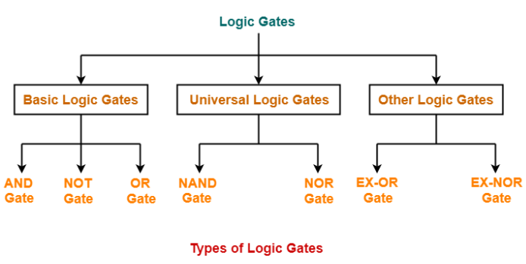
Digital Logic Gates
Logic gates are the basic building blocks of any digital circuit.

Slide 3
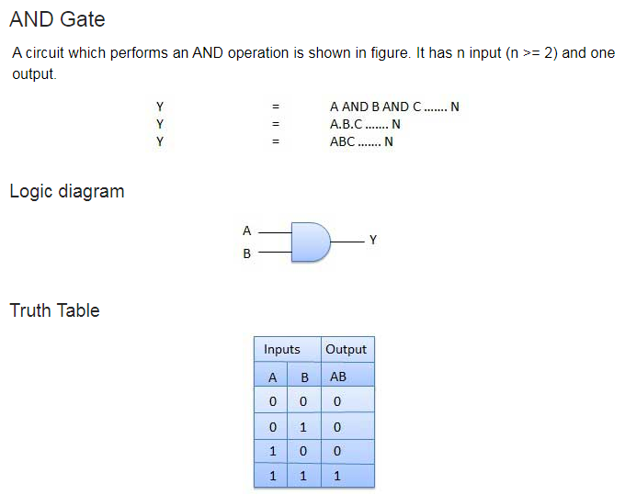

Slide 4
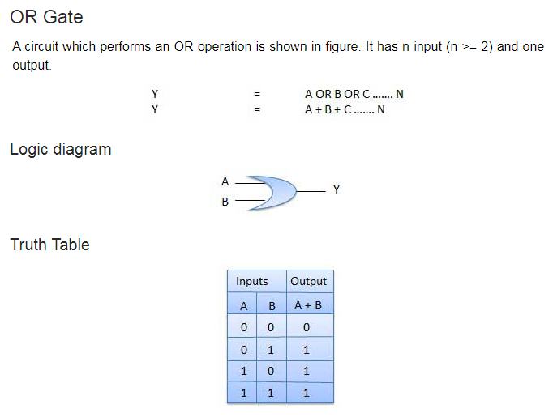

Slide 5
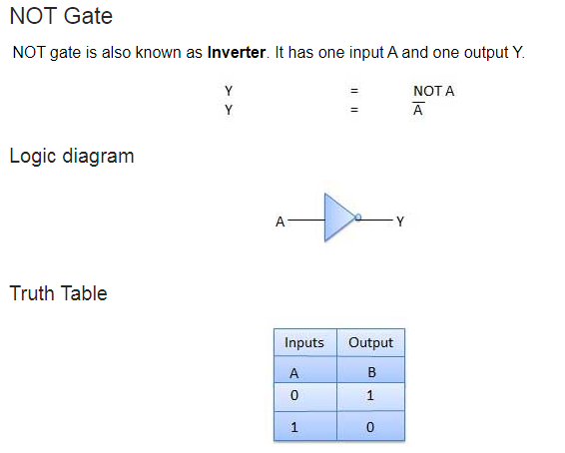

Slide 6
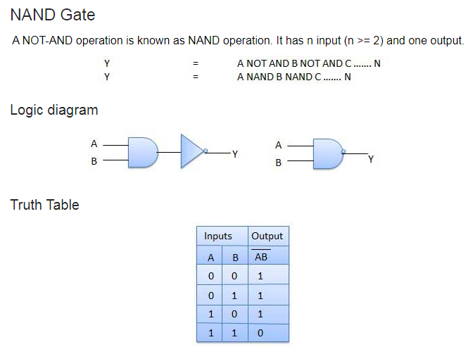

Slide 7
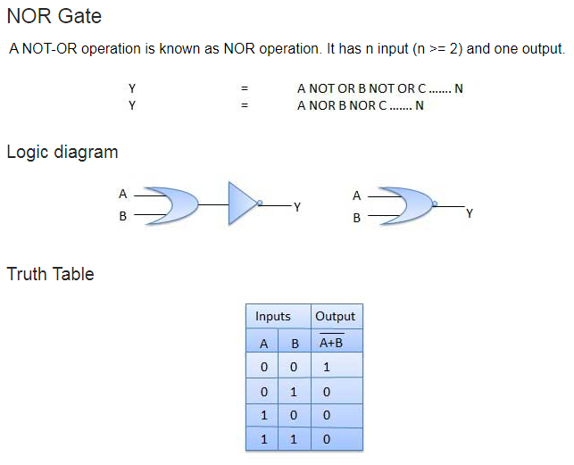

Slide 8
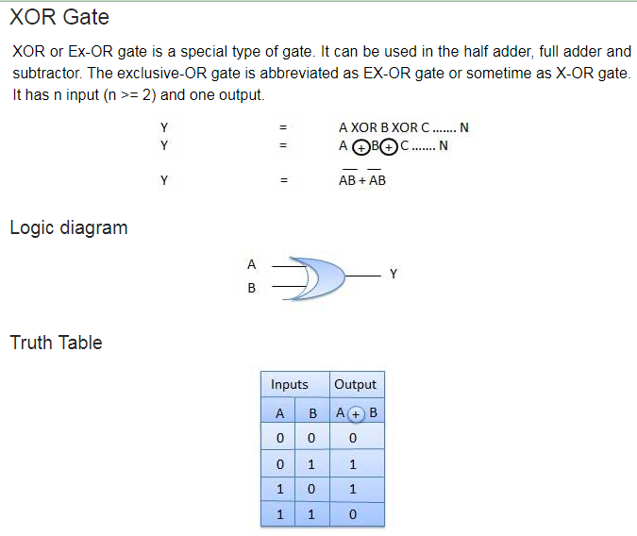

Slide 9
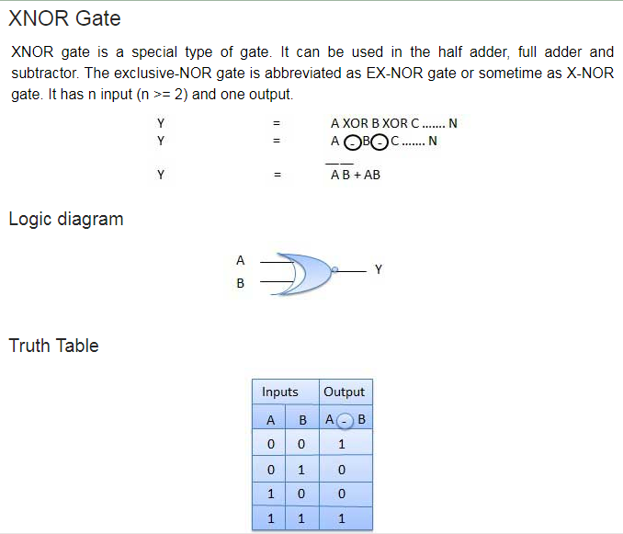

Slide 10

Axioms and Laws of Boolean Algebra

Slide 11
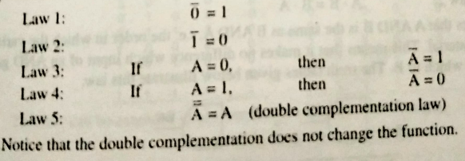
Complementation Laws

Slide 12
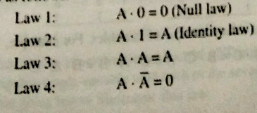

AND Laws
OR Laws

Slide 13
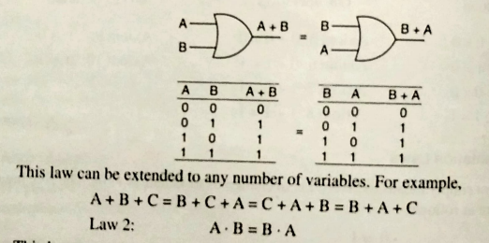
CommutativeLaw
This laws allow change in position of AND or OR variables.
Law 1: A+B = B +A
This law states that, A OR B is the same as B OR A,

Slide 14
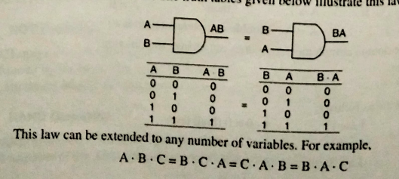
Law2: A.B=B.A

Slide 15
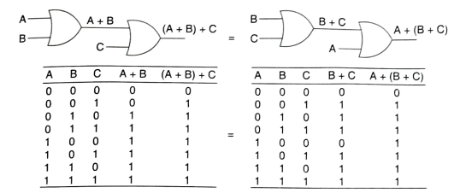

Associative Laws

Slide 16

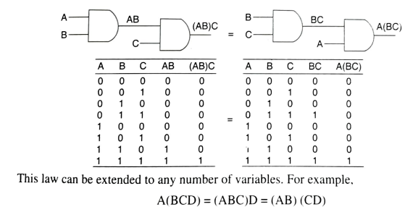

Slide 17

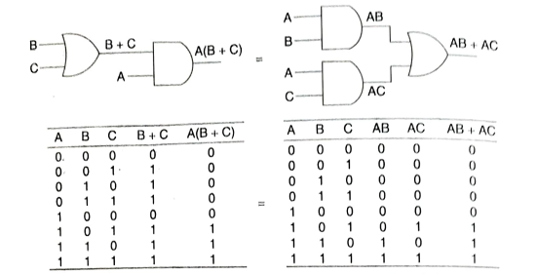
Distributive Laws

Slide 18

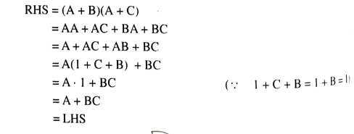

Slide 19
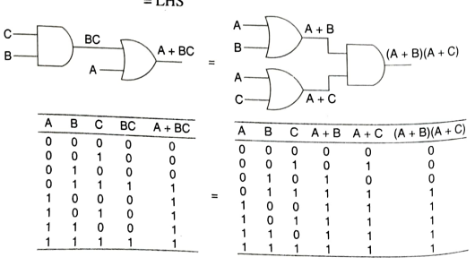

Slide 20

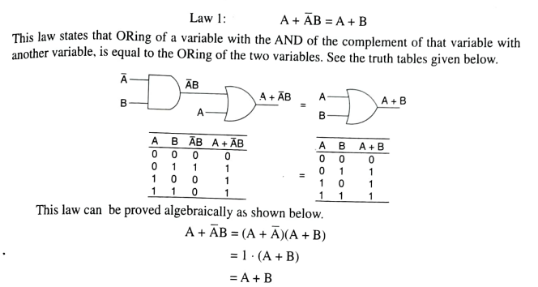

Slide 21
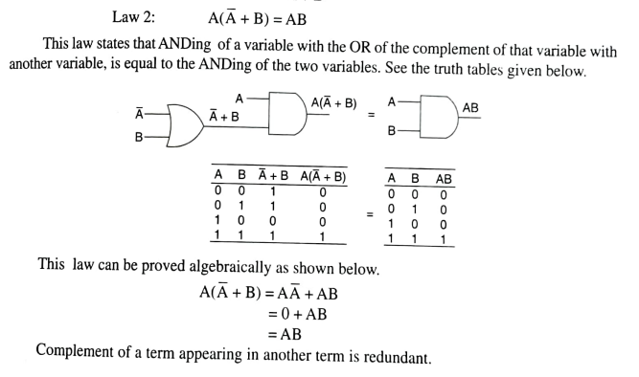

Slide 22



Slide 23
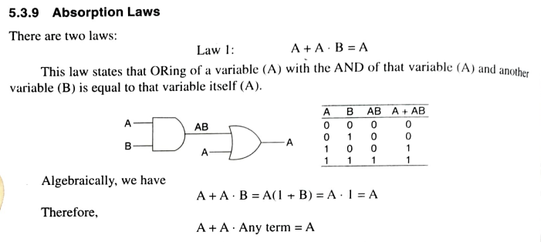

Slide 24
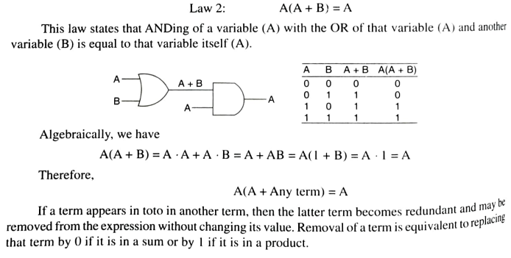

Slide 25

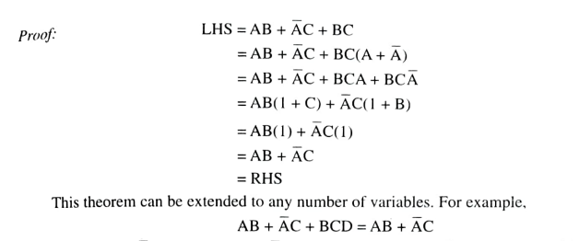

Slide 26



Slide 27
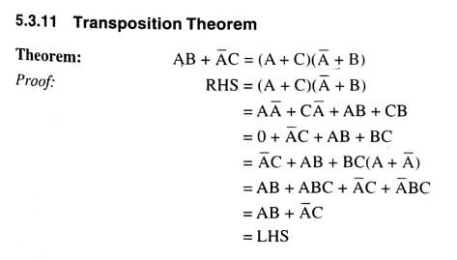

Slide 28

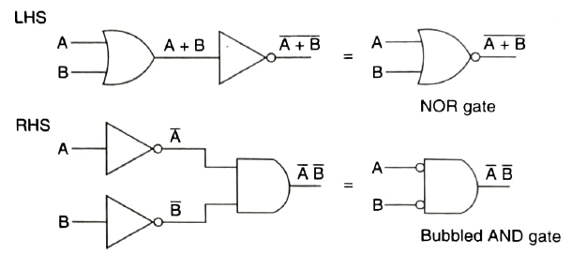
De Morgan’s Theorem

Slide 29




Slide 30




Slide 31



Slide 32

De Morgan’s Theorem

Slide 33

Sum of Product =>
Product of Sum =>

Slide 34



Slide 35


Slide 36
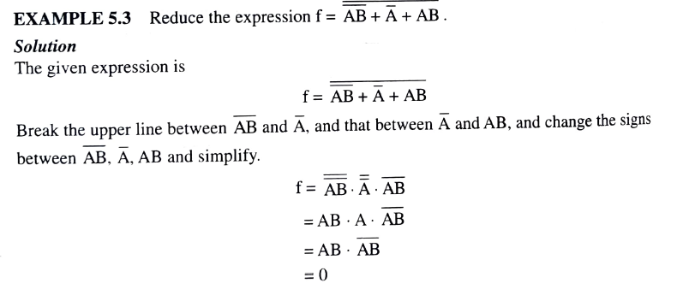

Slide 37



Slide 38
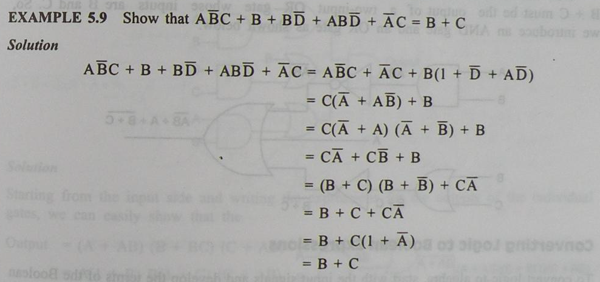

Slide 39
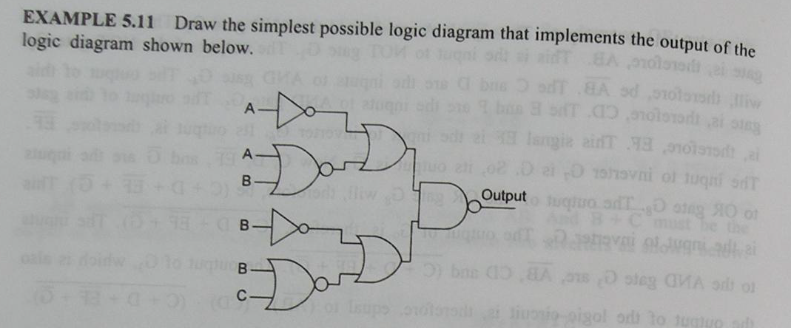

Slide 40
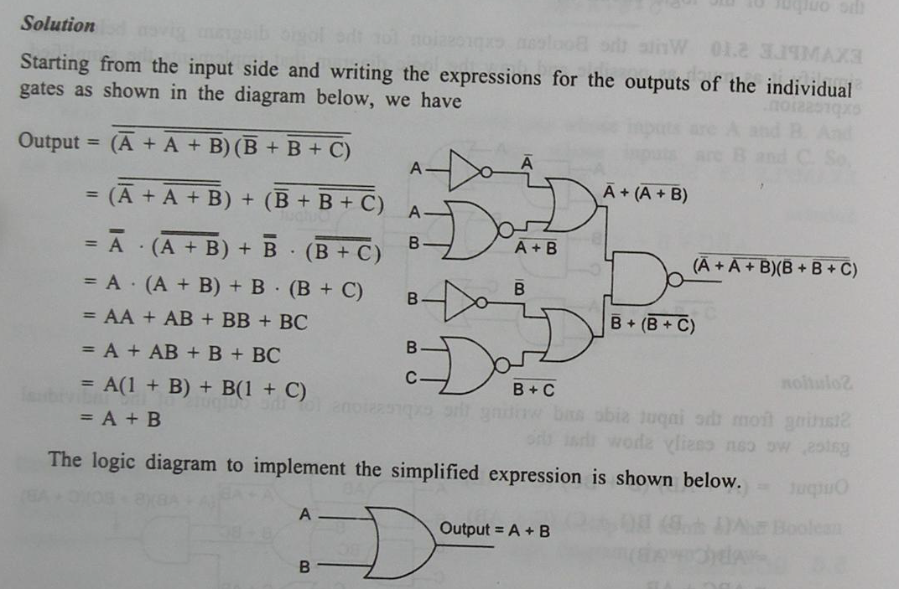

Slide 41

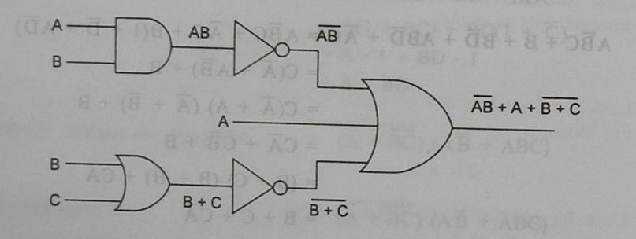
Draw the logic diagram for the given expression f=

Slide 43
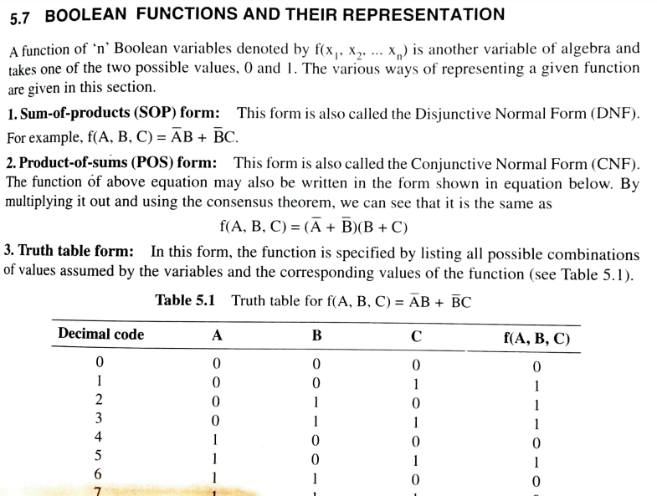

Slide 45
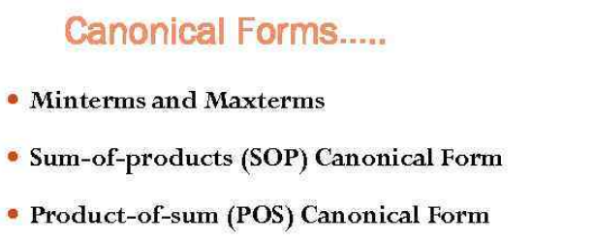

Slide 46
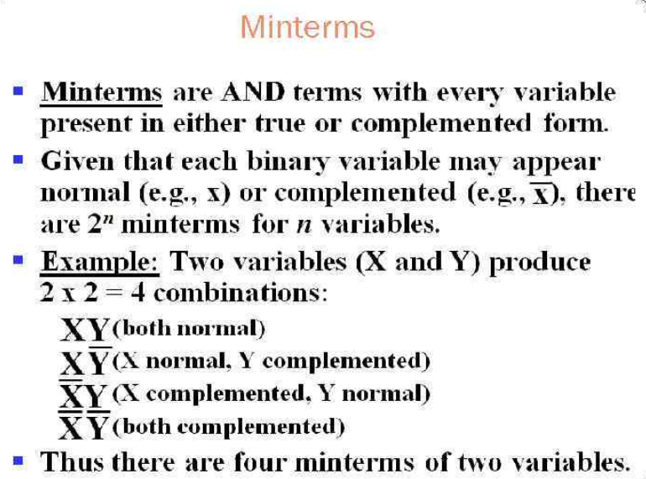

Slide 47
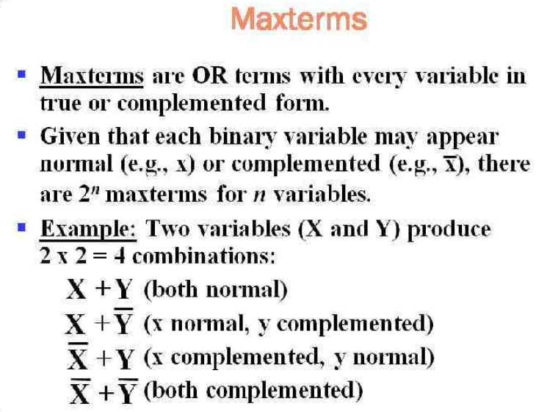

Slide 48
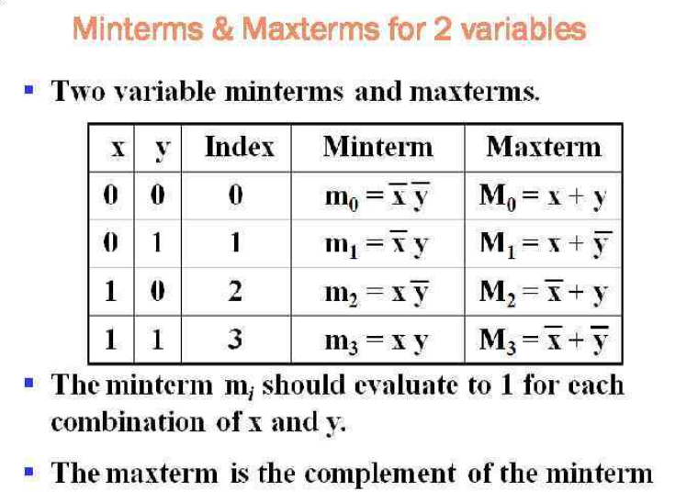

Slide 49
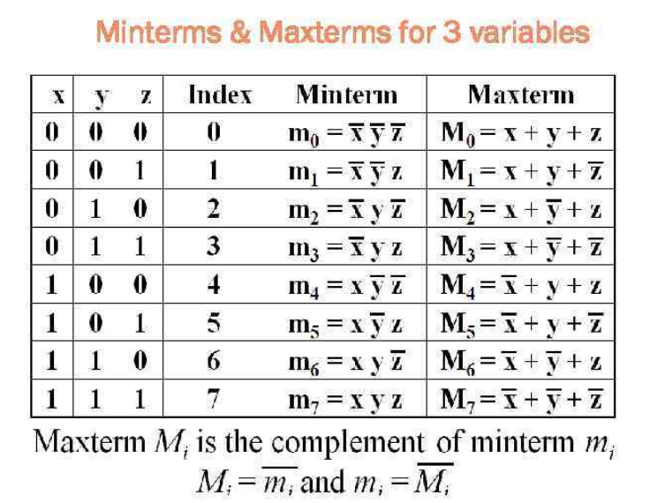

Slide 50
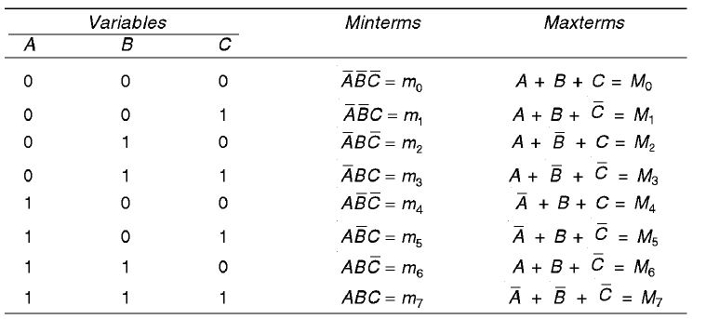

Slide 51
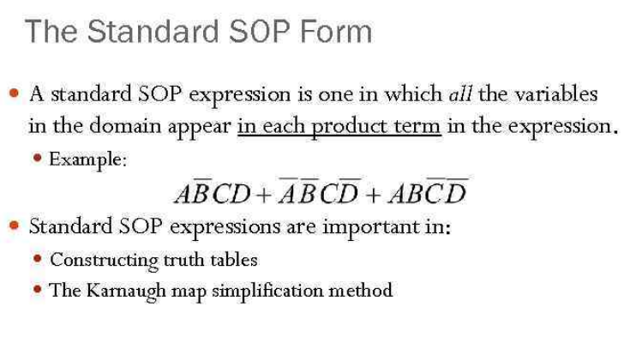

Slide 52
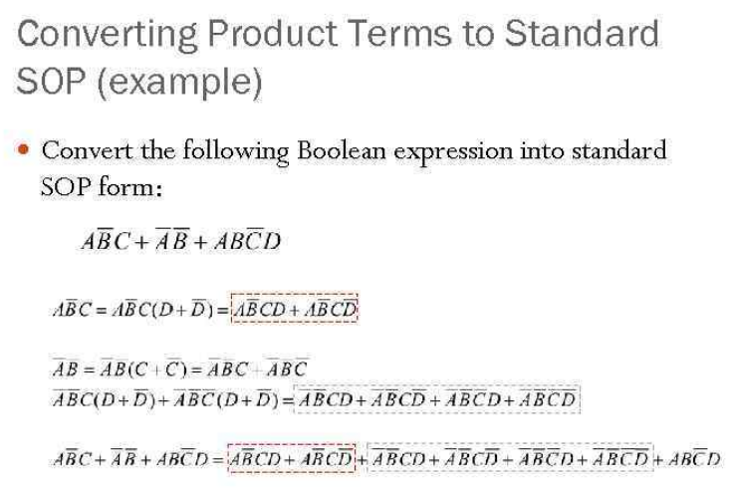

Slide 53
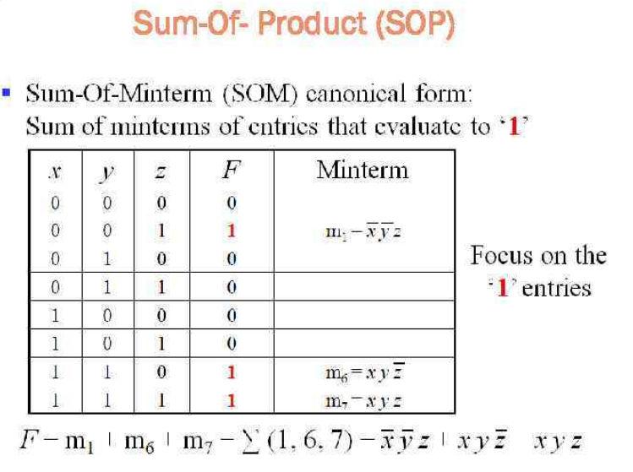

Slide 54
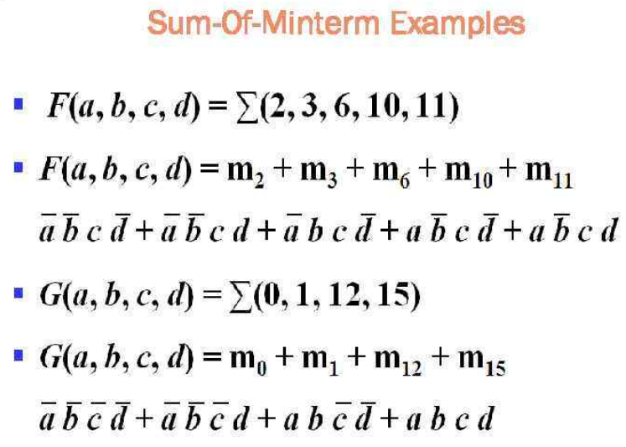

Slide 55
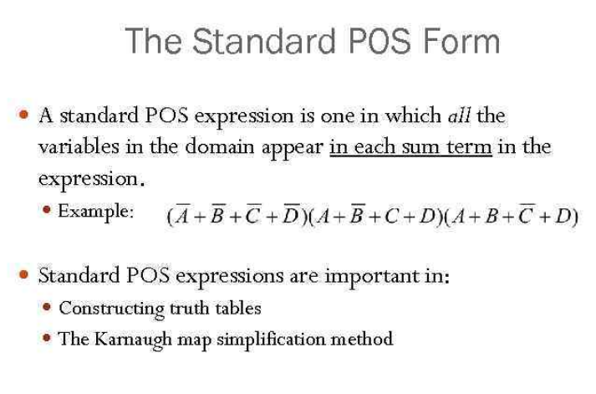

Slide 56
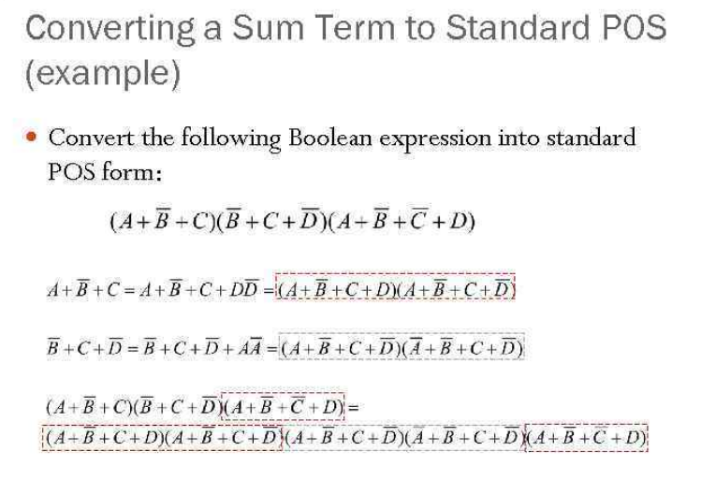

Slide 57
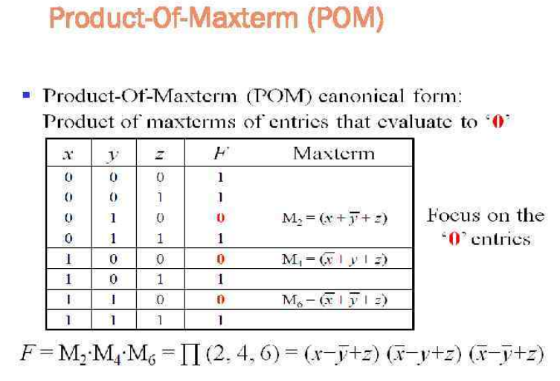

Slide 58
